Slide 1
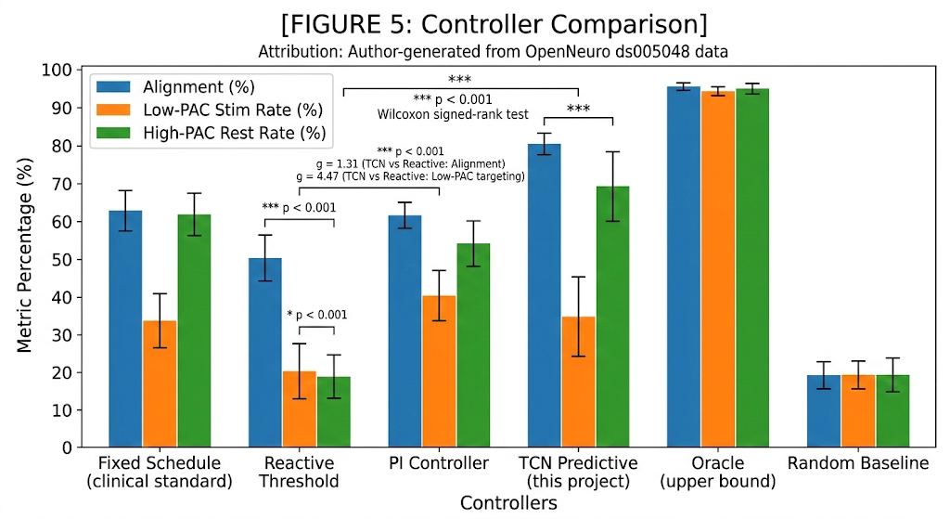
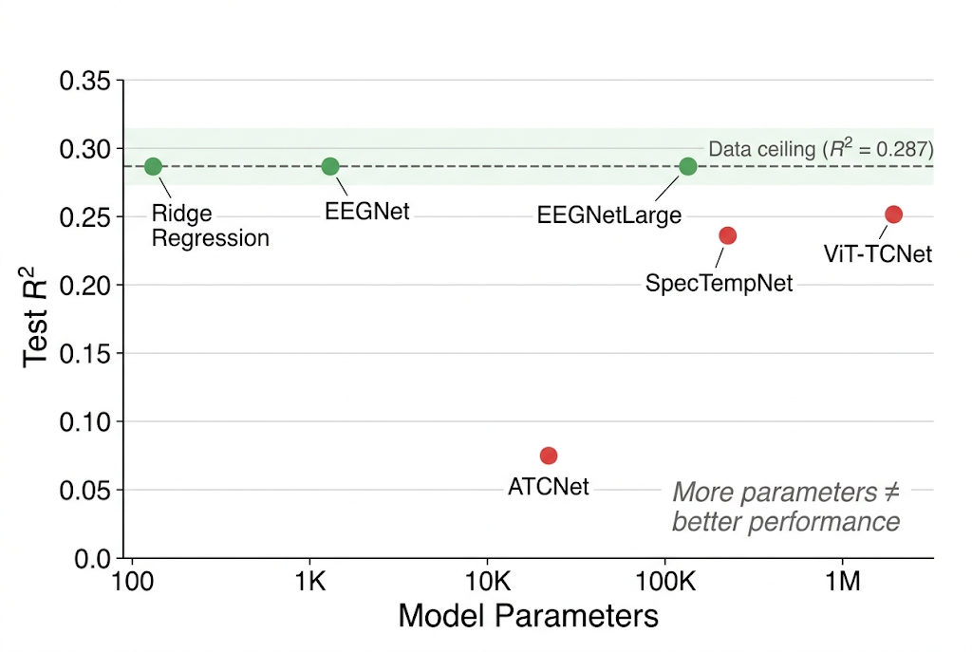
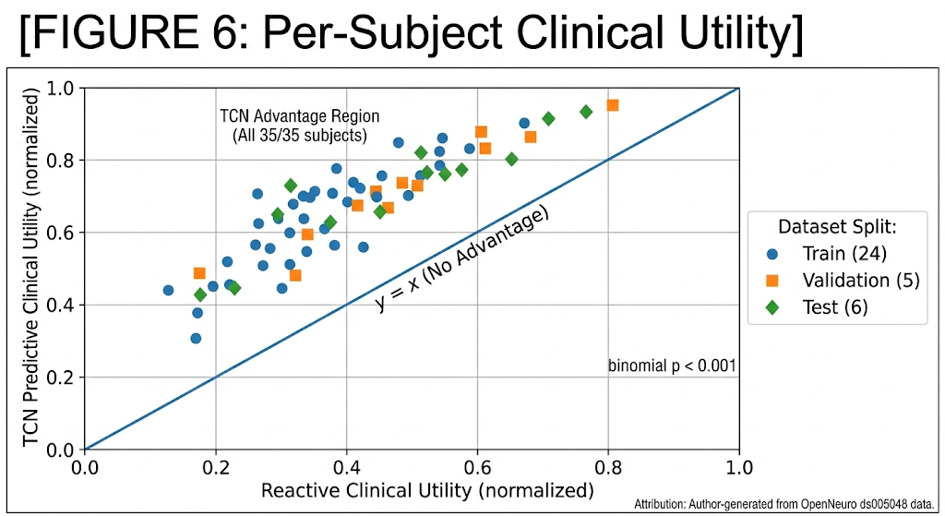
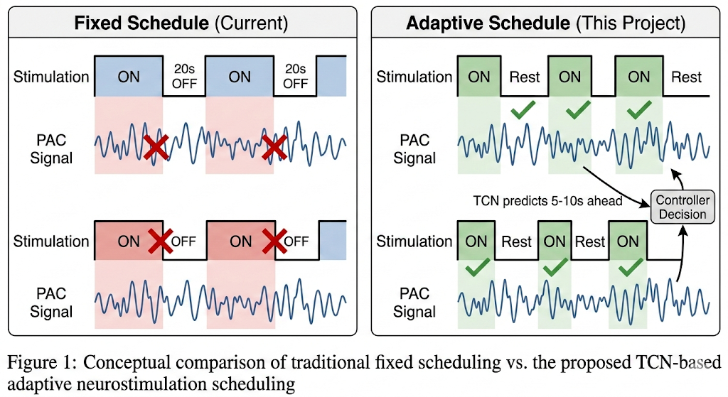
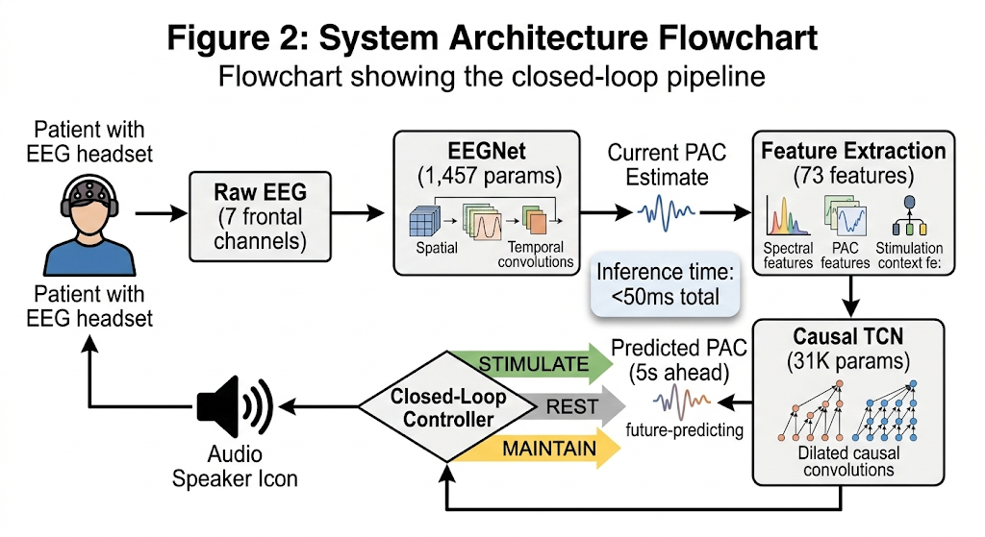
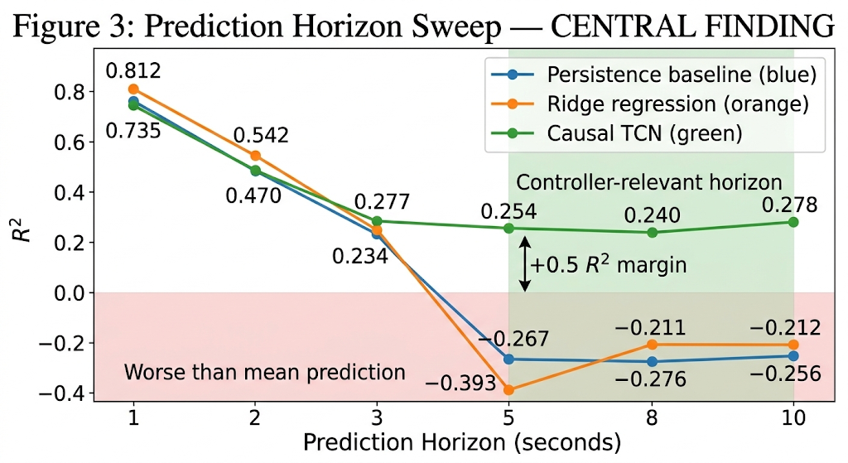
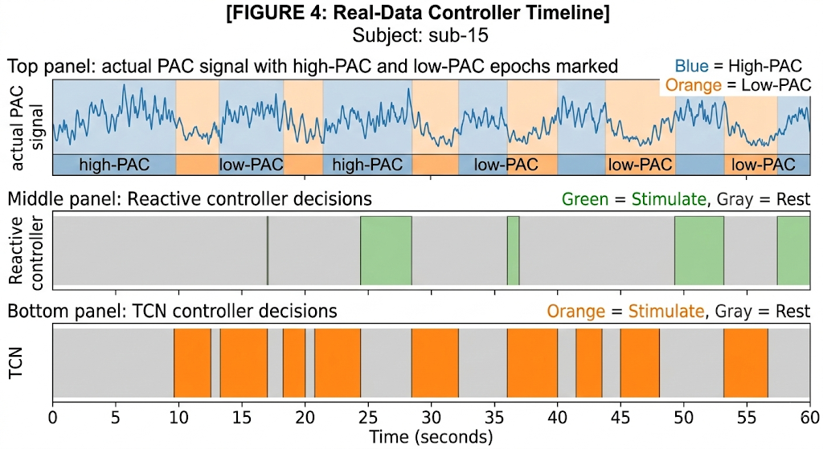
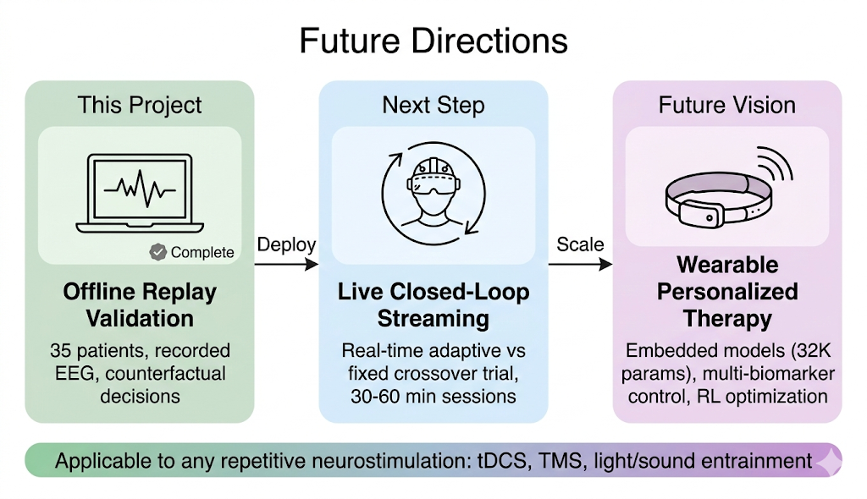
Personalized Deep Learning Model for Closed-Loop 40 Hz Entrainment to Optimize Theta-Gamma Phase Amplitude Coupling in Alzheimer’s Disease
Amaar Chughtai
Introduction
Materials
Architecture Exploration
Results & Findings
Alzheimer's disease affects over 55 million people worldwide, with no cure and limited treatment options. Recent neuroscience research has revealed a promising approach: 40 Hz auditory stimulation can synchronize brain gamma oscillations, reducing amyloid-beta plaques and tau tangles in animal models and showing early cognitive benefits in human clinical trials. Current clinical protocols deliver stimulation on a rigid fixed schedule, of 40 seconds of 40 Hz auditory stimulation followed by 20 seconds of silence, cycling continuously for one hour regardless of how the patient's brain is responding. During the "on" periods, the brain may already be well-entrained and not need stimulation; during the "off" periods, entrainment may be fading and the brain could benefit from continued stimulation. Some patients maintain strong theta-gamma coupling throughout a session, while others lose coupling within seconds of stimulus onset; their brains never fully synchronize. Within a session, even in patients who initially entrain well, prolonged repetitive stimulation causes neural habituation where gamma oscillation amplitude progressively weakens, theta-gamma coupling degrades, and the brain effectively "tunes out" the stimulus. The result is wasted stimulation during periods of strong coupling and missed opportunities during periods of fading coupling. This project asks can we predict when a patient's brain will lose entrainment and deliver stimulation proactively, before the decline occurs?
Dataset:
35 dementia patients, OpenNeuro ds005048 (Lahijanian et al., 2024)
19-channel EEG at 250 Hz sampling rate; 7 frontal channels selected (Fp1, Fp2, F3, F4, F7, F8, Fz)
Alternating Stimulus (40 Hz AM auditory) & Rest epochs, 20-40 sec each
17,283 two-second analysis windows extracted
Subject-level train/validation/test splits (24/5/6 subjects)
Software & Compute:
Python 3.13, PyTorch (deep learning framework)
All training and inference run on Apple Silicon (MPS)
Full pipeline: preprocessing, PAC computation, model training, closed-loop simulation, statistical analysis
Two Neural Networks (sized for dataset to prevent overfitting):
Before building the temporal predictor, I tested 8 different neural network architectures for static PAC prediction estimating current PAC from a single 2-second EEG window. The architectures spanned three orders of magnitude in model size:
Result 1: TCN Predictive Control Outperforms All Alternatives
Controller performance replayed on all 35 subjects' real EEG:
Architecture | Params | Test R²
EEGNet (V1) | 1457 | 0.287
SpecTempNet (V3) | 180K | 0.236
ViT-TCNet (V4) | ~2M | 0.252
Ridge Regression (V5) | 135 coefs | 0.287
ATCNet (V8) | 25K | 0.075
EEGNetLarge (rigor) | 141K | 0.287
EEGNet, Ridge, & EEGNetLarge all converge to R² = 0.287, while SpecTempNet, ViT-TCNet, & ATCNet perform worse due to overfitting. This is a ceiling of the data set by epoch-level PAC labels on 2-second windows, not a model capacity limitation. The largest model (2M) performed worst among deep learning approaches due to overfitting. Thus, I shifted from predicting PAC better from single windows, to predicting it further into the future using sequences. The causal TCN, operates on 20-second temporal histories rather than 2-second snapshots.
Controller | Alignment | Low-PAC Targeting | PAC Gap (µV²) | Stim %
Fixed Schedule | 45.0% | 61.4% | -6.6 (wrong direction) | 66.6%
Reactive | 64.5% | 51.7% | +21.1 | 36.7%
TCN Predictive | 72.1% | 82.6% | +30.5 | 59.7%
Oracle (upper bound) | 100.0% | 100.0% | +33.3 | 48.3%
TCN vs Reactive: Alignment g = +1.31, Low-PAC targeting g = +4.47, PAC gap g = +1.57 (all p < 0.001, Wilcoxon signed-rank). TCN reaches 91% of the theoretical oracle bound.
 | EEGNet | Causal TCN
Purpose | Estimate current PAC from raw EEG | Predict future PAC from history
Parameters | 1457 (12 samples/param) | 31,043
Input | Raw EEG (7 ch x 500 samples) | 73 features x 20 timesteps
Architecture | Temporal + depthwise spatial conv. | Dilated causal conv (d=1,2,4,8)
Output | Current PAC Estimate | Future PAC (5s Horizon)
Key Feature | Real-time-inference | 44-second receptive field, causal (no future leakage)
Literature Review
40 Hz Gamma Entrainment: Iaccarino et al. (2016) first demonstrated that 40 Hz light flickering reduces amyloid load in Alzheimer's mouse models by activating microglia. Martorell et al. (2019) extended this to multi-sensory (auditory + visual) stimulation, showing reduced amyloid and tau pathology with improved cognition. Lahijanian et al. (2024) confirmed that auditory gamma entrainment enhances default mode network connectivity in human dementia patients.
Phase-Amplitude Coupling (PAC): PAC measures how strongly high-frequency gamma amplitude (38-42 Hz) is modulated by lower-frequency theta phase (4-8 Hz). Tort et al. (2010) established the Modulation Index as the standard quantitative measure. High PAC indicates successful entrainment; low PAC indicates the brain has lost synchronization with the stimulus.
Neural Habituation: Thompson & Spencer (1966) established that repeated identical stimuli produce progressively weaker neural responses. In 40 Hz entrainment, fixed schedules become less effective over time meaning the brain "tunes out" the repetitive stimulus, producing diminishing PAC.
No existing system predicts future entrainment state to enable proactive control. Current approaches either use fixed schedules (no adaptation) or reactive thresholds (respond after decline has already occurred, introducing delay).
Methods
Result 2: Every Patient Benefits
PAC Computation. To quantify how well a patient's brain is entrained to the 40 Hz stimulus, I computed phase-amplitude coupling (PAC) using the Modulation Index method (Tort et al., 2010). PAC measures how strongly high-frequency gamma amplitude (38-42 Hz) is modulated by lower-frequency theta phase (4-8 Hz). When the brain is successfully entrained, gamma oscillations lock to the theta rhythm, producing a high Modulation Index. When entrainment is lost, gamma and theta decouple and the index drops. I computed PAC at the epoch level (full 20-40 second stimulus or rest blocks) and assigned the value to each constituent 2-second window within that epoch.
Causal Temporal Dataset Construction. To predict future PAC, I constructed temporal sequences from the processed EEG windows. Each timestep contains 73 input features: 61 spectral power features capturing band power across frequency ranges, 7 PAC-derived features reflecting current coupling strength and recent trends, and 5 stimulation context features encoding whether the patient is currently receiving stimulation or resting, and for how long. The model receives 20 timesteps of history (20 seconds) and predicts PAC 5 seconds into the future. No input feature at time t contains any information from time t+1 or beyond. All features and targets were z-score normalized using statistics computed only from the training set, so no information from validation or test subjects could leak into the model.
Closed-Loop Controller. The controller takes the TCN's predicted future PAC and turns it into a stimulation decision. It maintains a rolling 30-second baseline of each patient's recent PAC values and converts the prediction into a personalized z-score. If the z-score falls below -0.5, meaning coupling is predicted to decline, the controller triggers STIMULATE. If it rises above +0.5, meaning coupling is predicted to remain strong, the controller signals REST. Otherwise, it holds the current state (MAINTAIN). A 5-second hysteresis window prevents rapid switching between states. Because the TCN predicts 5 seconds ahead, the controller begins stimulating before the patient's coupling drops, rather than waiting to react after the decline has already occurred.
Procedures
Model Training. I trained the EEGNet on raw EEG windows to estimate current PAC, using mean squared error (MSE) loss, the Adam optimizer, and gradient clipping at max_norm=1.0 to stabilize training. Early stopping halted training when validation performance stopped improving, preventing the model from memorizing the training data. I trained the Causal TCN on temporal sequences to predict future PAC using Huber loss for robust regression, which reduces sensitivity to PAC outliers compared to MSE. The model architecture supports optional multi-task learning (delta prediction + consistency penalty) but the best checkpoint uses single-task Huber loss. The learning rate was reduced automatically when validation loss plateaued, and training stopped if 20 consecutive epochs passed without improvement (early stopping patience of 20). All hyperparameter decisions were made using the validation set (5 subjects). The test set (6 subjects) was used only for the final reported evaluation and was never seen during model development.
Validation Protocol. For the primary validation, I replayed the TCN controller on all 35 subjects' actual EEG recordings. The controller processed each subject's data as if running in real time, making stimulation decisions at every 2-second window based on the model's predictions. This tests the controller on real brain data, though because the recordings are historical, the controller cannot observe how the brain would respond to its decisions (offline counterfactual replay). For a secondary validation, I ran closed-loop simulations that model neural fatigue, where the brain's response to stimulation progressively weakens over time. I tested across 6 fatigue severity levels (none through severe), running 50 independent 600-second trials per condition. All statistical comparisons used Wilcoxon signed-rank tests (non-parametric, paired), bootstrap 95% confidence intervals, and Hedges' g effect sizes. I compared four control strategies: Fixed Schedule (the current clinical standard of 40s on / 20s off), Reactive Threshold (responds to current PAC after decline has already occurred), PI Controller (proportional-integral feedback), and Alignment Oracle (perfect future knowledge, serving as the theoretical upper bound on what any controller could achieve).
35/35 subjects (100%) show higher clinical utility with TCN vs Reactive (binomial p < 0.001). The advantage holds across train (24), validation (5), and test (6) subject splits, including 6 subjects the model never saw during training.
Result 3: Adaptive Advantage Increases with Fatigue
Simulation results across 6 fatigue severity levels (n = 50 trials each):
Fatigue Level | Fixed Efficiency | Adaptive Efficiency | Improvement
None | 0.343 | 0.375 | +9.5%***
Mild | 0.341 | 0.375 | +10.0%***
Moderate | 0.335 | 0.366 | +9.0%***
High | 0.319 | 0.354 | +10.8%***
Severe | 0.316 | 0.352 | +11.2%***
***p < 0.001, Wilcoxon signed-rank, Hedges' g = 1.7-2.4 (large-very large effects) The adaptive advantage generally grows from +9.0% to +11.2% as fatigue worsens, exactly when personalization matters most.
Result 4: Robust Across Fatigue Model Assumptions
Tested under 4 different mathematical models of neural fatigue (n = 50 trials each):
Hypothesis
Fatigue Model | Advantage | P-value | Hedges’ g
Exponential Decay | +9.0% | 1.8 × 10⁻¹⁵ | 2.31
Step Function | +6.9% | 4.4 × 10⁻¹⁴ | 1.21
Heterogenous (50/50) | +8.9% | 2.5 × 10⁻¹⁴ | 1.71
Saturation (synaptic) | +19.0% | 1.8 × 10⁻¹⁵ | 3.66
A causal temporal convolutional network can predict future PAC at 5-10 second horizons where simpler methods fail, enabling adaptive stimulation scheduling that targets periods of genuine therapeutic need.
Prediction: Build a deep learning model that predicts brain entrainment state 5-10 seconds into the future — the minimum lead time required for a controller to act proactively
Control: Integrate predictions into a closed-loop controller that decides when to stimulate, rest, or maintain current state
Validation: Demonstrate on real patient EEG data (not just simulation) that predictive control outperforms both fixed schedules and reactive approaches
Data, Charts, & Models
The adaptive scheduling advantage is not an artifact of one fatigue assumption. It holds under all four models with large effect sizes.
Subject-level splits prevent data leakage (6 held-out test subjects never seen during training) Shuffle-label test: R² = -0.332 (model learns real signal, not artifacts) Causal dataset construction verified (no future information in input features) Feature ablation confirms interpretability: PAC-derived features drive prediction, spectral features provide independent signal.
Figure 3 captures the project's central finding. At short prediction horizons (1-2 seconds), simple baselines perform well; persistence (just repeating the last observed value) achieves R² = 0.76, and Ridge egression reaches 0.81. At these timescales, PAC changes so little that "nothing will change" is a strong prediction, and the TCN offers no advantage.
But a closed-loop controller cannot act on 1-second predictions. By the time the system detects a decline, decides to stimulate, and the brain begins responding, 5-10 seconds have elapsed. This is the operationally relevant prediction window. At exactly these horizons, both baselines collapse to negative R² — performing worse than simply predicting the population mean — because PAC dynamics shift substantially over 5-10 seconds as stimulation blocks begin and end.
The causal TCN (bottom of figure 4), by contrast, maintains R² of approximately 0.25 across the entire 5-10 second range. This +0.5 R² margin over baselines is what transforms PAC prediction from an academic exercise into a practical tool for proactive stimulation control.
References
Iaccarino, H. F., et al. (2016). Gamma frequency entrainment attenuates amyloid load and modifies microglia. Nature, 540(7632), 230-235.
Martorell, A. J., et al. (2019). Multi-sensory gamma stimulation ameliorates Alzheimer's-associated pathology and improves cognition. Cell, 177(2), 256-271.
Tort, A. B., et al. (2010). Measuring phase-amplitude coupling between neuronal oscillations of different frequencies. Journal of Neurophysiology, 104(2), 1195-1210.
Lawhern, V. J., et al. (2018). EEGNet: A compact convolutional neural network for EEG-based brain-computer interfaces. Journal of Neural Engineering, 15(5), 056013.
Lahijanian, M., et al. (2024). Auditory gamma-band entrainment enhances default mode network connectivity in dementia patients. Scientific Reports, 14, 13153.
Thompson, R. F., & Spencer, W. A. (1966). Habituation: A model phenomenon for the study of neuronal substrates of behavior. Psychological Review, 73(1), 16-43.
Further Research
Conclusions
Deploy with live EEG streaming for real-time crossover validation (adaptive vs fixed within same session)
Record 30–60-minute sessions to capture the full habituation time course
Replace the heuristic controller with reinforcement learning for long-horizon optimization
Extend to multi-biomarker control (PAC + spectral power + connectivity)
At 5-10 second prediction horizons, the causal TCN maintains R² ≈ 0.25 while all baselines collapse below zero, a +0.5 R² margin at the operationally relevant range for proactive neural stimulation control
When integrated into a closed-loop controller and validated on real patient EEG, the TCN achieved 72.1% alignment versus 64.5% reactive (p < 0.001), targeting 82.6% of low-PAC windows compared to 51.7%, a 60% improvement in therapeutic targeting
All 35 patients benefited from TCN-based control, including 6 held-out test subjects, demonstrating generalization across individual EEG patterns
The adaptive advantage increases with fatigue severity (+9.0% to +11.2%) and holds across four different fatigue model assumptions, confirming robustness
Half of patients habituate to stimulation while half do not, validating the fundamental need for personalized rather than fixed scheduling
Limitation: Real-data validation uses offline replay (counterfactual decisions on recorded EEG), not live closed-loop streaming. The system makes decisions on real brain data but cannot observe the brain's response to those decisions.
Acknowledgements
Data Source: OpenNeuro dataset ds005048 (Lahijanian et al., 2024). All EEG data used under open access license.

